Slide 1
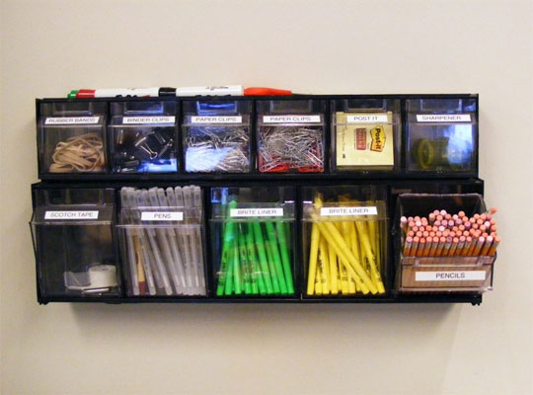
Organizing for Q A
How to make the models testable with the MVVM framework

Slide 2

Basic Idea
Try to remove dependencies
Try to namespace objects
Functions should do 1 thing
Functions names should say that 1 thing
Group like kind dependencies
Scripts and CSS
Header
Logic
Events
Diary

Slide 3
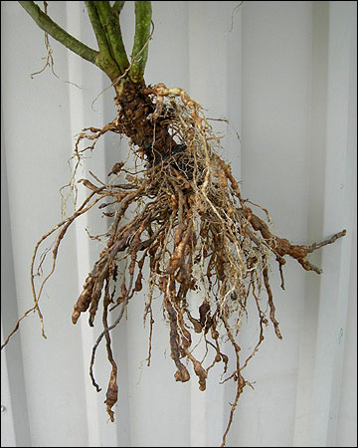
Root page structure
Layout
Scripts -2 big dependencies jQuery and kendo
Header
Tabs
Includes all partials
Modals div
Events
Diary
Logic
Call to logic object to bind to page

Slide 4

What this allows us to do
TestLayout Page
Scripts
Logic
Arrange
Call any partial to test
Act
Call the logic page with known values
Assert
Make sure the values are what is expected

Slide 5

Logic Structure
xObject ={
getDataUrl
hasErrors
xViewModel:{}
verifyModel:{}
bindData:function(jQueryObject)
setData=fuction(data,jQueryObject)
Used for testing
Sets xViewModel
Calls bindData
setAjaxData:function(xId,jQueryObject)
Used by root page to get data
Sets setData to create xViewModel
Calls bind Data

Slide 6
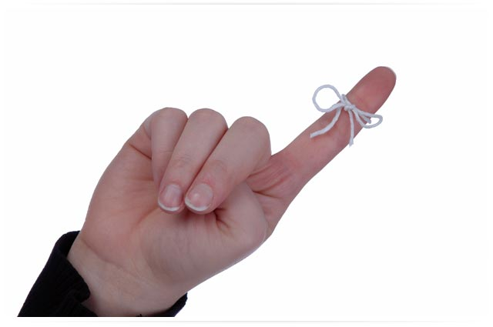
Important Points
Logic Object doesn’t call itself
Testing creates the UOW and calls the setData method
Root page calls setAjaxData to pull real data
Or Root page calls the setData passing the Html.Raw data
The viewmodel called in setData must set all functions and jsObjects

Slide 7
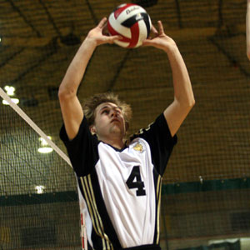
setData
Passes a jsObject called data
Passes the jQuery object to bind
xObject.xViewModel=kendo.observable({
xData:data.xDataItems
dropdownItems:data.dropdownItems
otherUofWorkObjects:data.objectName
otherFunctions:function(){},
Events:{data.xData.Events}
})
bindData
kendoBeautify.FixAllKendoControlsWidths() after binding

Slide 8

bindData
Binds ViewModel to pass object

Slide 9
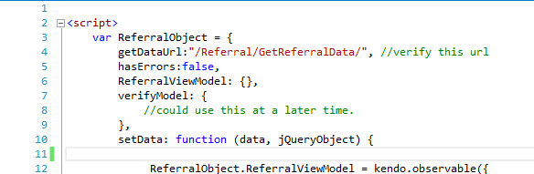

Walking through an example

Slide 10
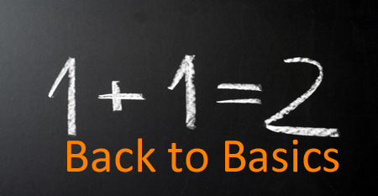
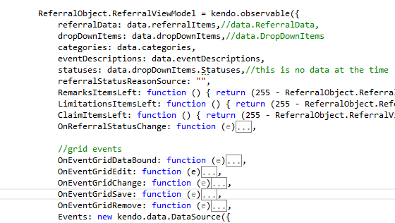
Basic objects and functions

Slide 11
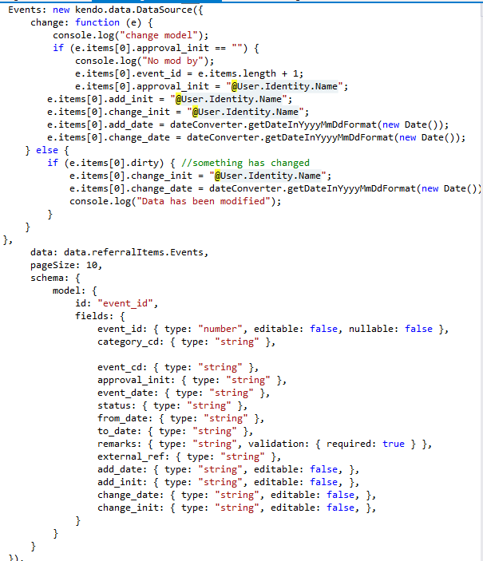
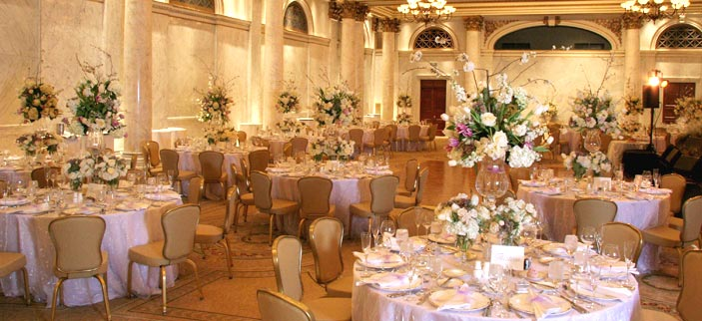
Events

Slide 12
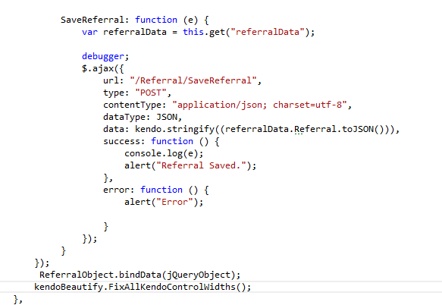
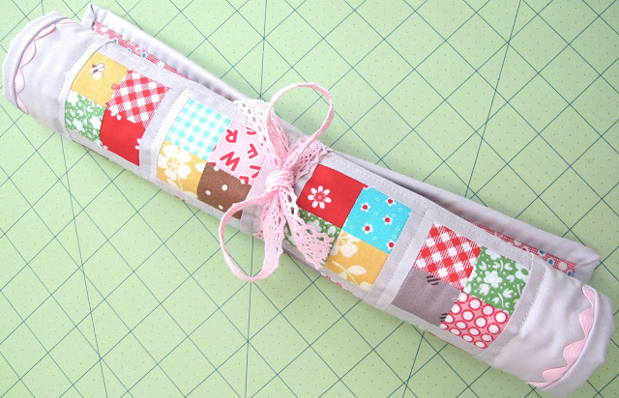
Do other functions and bind

Slide 13


bindData

Slide 14

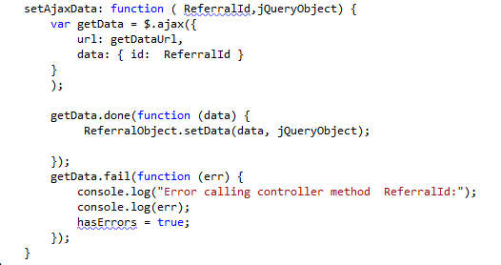
setAjaxData

Slide 15

Calling object before Ajax calls exist
xObject.setData(‘@Html.Raw(Json.Encode(Model.CallData))’,$(“#myObject”))

